Slide 1

Multiple Sclerosis Disease Prediction model
Use of Machine Learning to predict patients having
Multiple Sclerosis Disease
Team members:
Michalis Kontis
Panagiotis Apostolou

Slide 2
Purpose of presentation
In this presentation we will analyze:
What is "Multiple Sclerosis Disease"
Provide prediction model based on machine learning algorithms
Show most important factors that contribute to the disease

Slide 3
Glossary
Schooling: Number of years the patient spent in schooling
Varicella: Another name for Chickenpox
Oligoclonal_Bands: Proteins, whose presence indicates inflammation of the central nervous system
Somatosensory evoked potentials (SSEPs) are a viable way to measure processing of somatosensory information
LLSSEP: Long-Latency Somatosensory Evoked Potentials of the Subthalamic Nucleus in Patients with Parkinson’s Disease
VEP: Variant Effect Predictor, determines the effect of your variants (SNPs, insertions, deletions, CNVs or structural variants) on genes, transcripts, and protein sequence, as well as regulatory regions
BAEP: Brainstem Auditory Evoked Potentials is an evoked potential caused by an aural stimulus (a sound), usually a series of 'clicks'.
Periventricular MRI: The periventricular nucleus is a thin sheet of small neurons located in the wall of the third ventricle

Slide 4
What is Multiple Sclerosis Disease
It is an autoimmune condition that can affect the brain and spinal cord
Causes a wide range of potential symptoms
Lifelong condition that can sometimes cause serious disability
It's about 2 to 3 times more common in women than men.
It's most commonly diagnosed in people in their 20s, 30s and 40s

Slide 5
Symptoms
Fatigue
Difficulty walking
Vision problems
Problems controlling the bladder
Numbness or tingling in different parts of the body
Muscle stiffness and spasms
Problems with balance and co-ordination
Problems with thinking, learning and planning

Slide 6
Types of multiple sclerosis
Relapsing remitting MS
Primary progressive MS
Between 8 and 9 of every 10 people with MS are diagnosed with the relapsing remitting type.
Will have episodes of new or worsening symptoms, known as relapses.
The symptoms of a relapse may disappear altogether, with or without treatment
Symptoms gradually worsen over time without obvious attacks.
Between 1 and 2 in every 10 people with the condition start their MS with a gradual worsening of symptoms.
Symptoms gradually worsen and accumulate over several years
There are no periods of remission
There are often periods where their condition appears to stabilise

Slide 7
Dataset
This data was collected in a study conducted in Mexican mestizo patients newly diagnosed with CIS (Clinically isolated syndrome) who presented at the National Institute of Neurology and Neurosurgery (NINN) in Mexico City, Mexico, between 2006 and 2010.
The sample size was 273 patients of whom 125 were giagnosed with the disease.

Slide 8
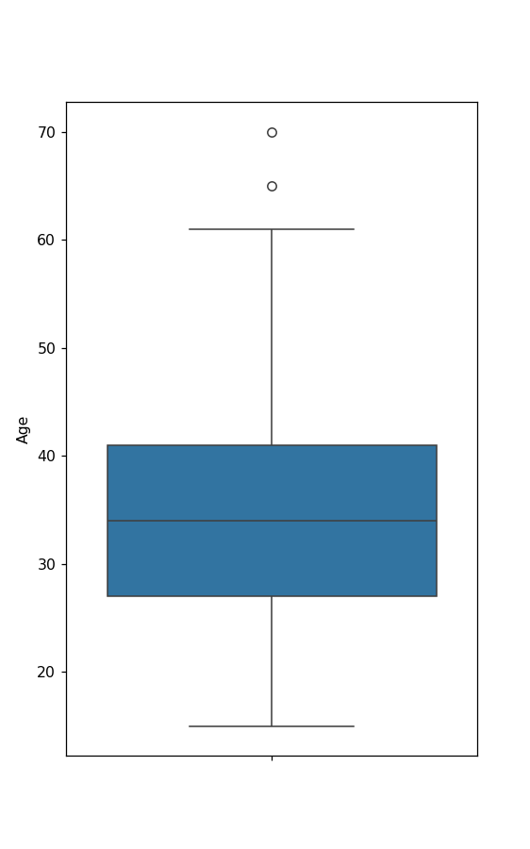
Age range
We observe that the mean of age of patients is around 35.
The age range for the majority is between 27 and 40.

Slide 9
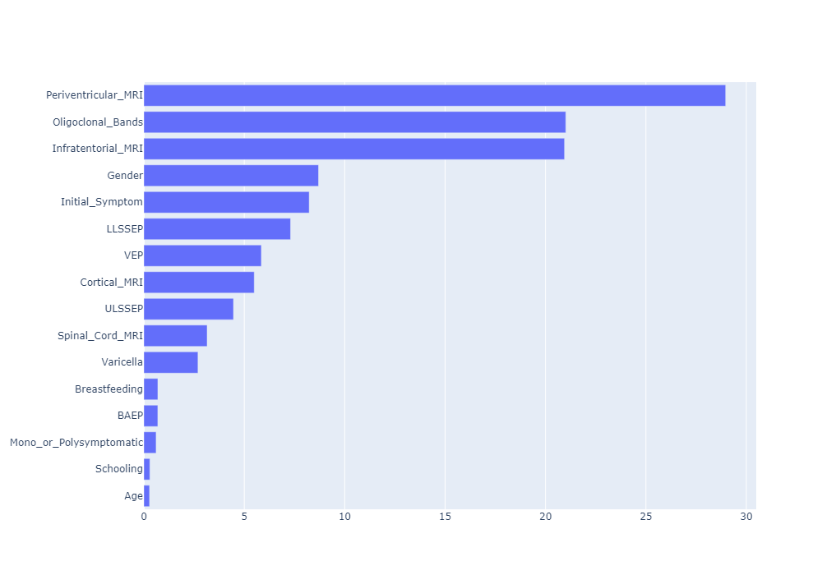
Most important factors for diagnosis

Slide 10
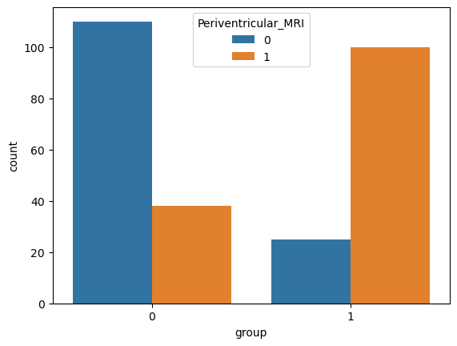
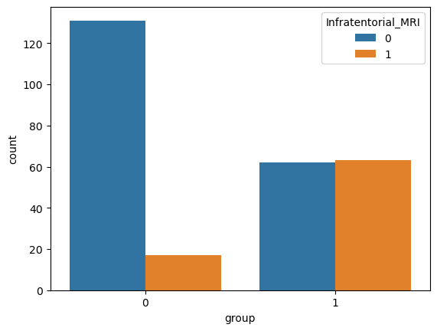
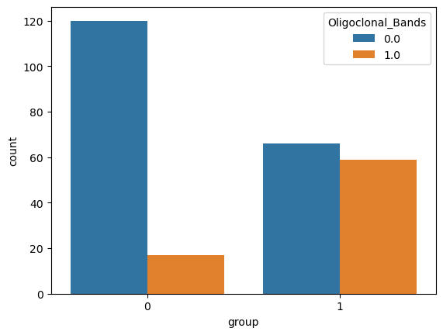
Most important factors for diagnosis

Slide 11
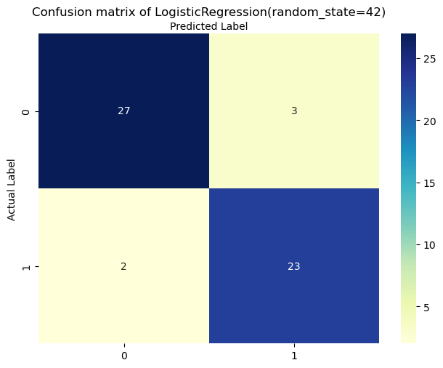
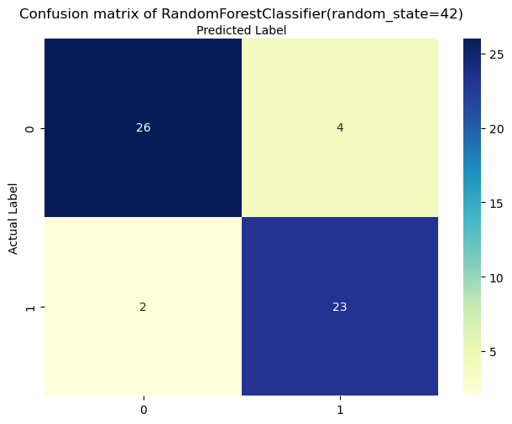
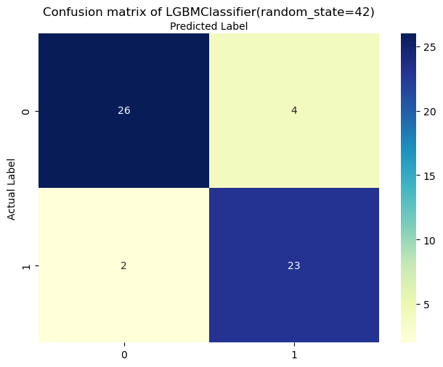
Prediction model goals
The objective of the model is to minimize the wrong missclassification for the patients who indeed have MSD.
Below are the 3 best classifiers results:

Slide 12
Summary
MSD first symptoms occur between mid 20s until 40's
Model score has 92% propability to pinpoint patients
More data would lead to better model prediction/tuning

